Slide 1
Data Wrangling – Part 1

Slide 2
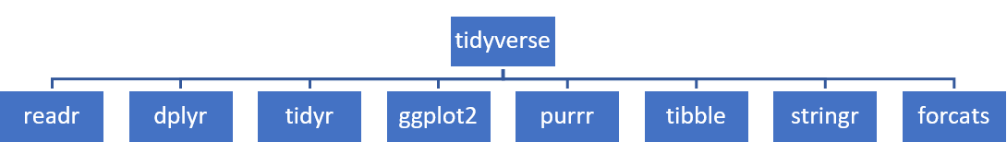
tidyverse Package
Tidyverse: is a collection of R packages designed to facilitate data manipulation, exploration, visualization, and modeling.

Slide 3
Reading Data

Slide 4
Examining the Data
slice(): Display the first few rows
Command: slice(name_of_dataframe, 1:5)
Example 2: slice(penguins, 1:3)

Slide 5
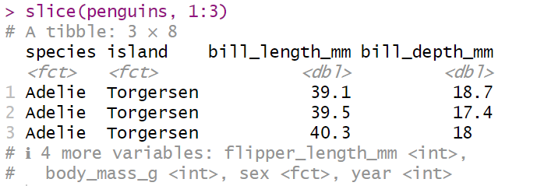

Slide 6
glimpse(): Get summary of the variables
Command: glimpse(name_of_dataframe)
Example 3: glimpse(penguins)

Slide 7
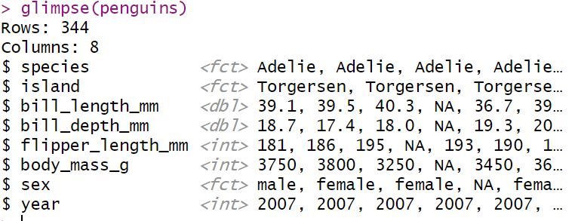

Slide 8
str(): Display the structure of the data
Command: str(name_of_dataframe)
Example 4: str(penguins)

Slide 9
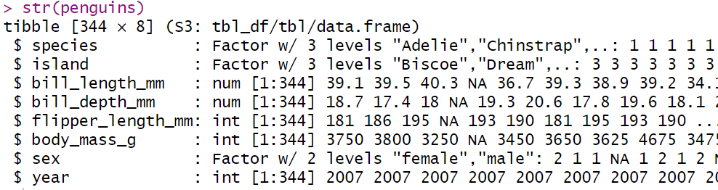

Slide 10
table(): it’s typically used for one or two columns. For one column, it tabulates each observation, and shows how many times each observation appeared (or repeats) in that column.
Command: table(name_of_dataframe$name_of_column)
table(name_of_dataframe$name_of_column1, name_of_dataframe$name_of_column2)

Slide 11
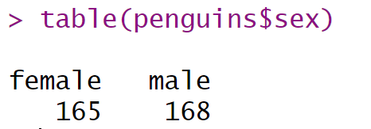
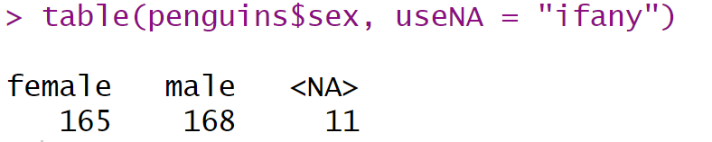
Example 5: table(penguins$sex)
table(penguins$sex, useNA = "ifany")

Slide 12
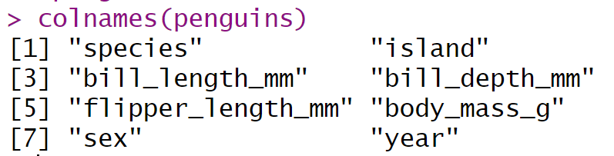
colnames(): Display the structure of the data
Command: colnames(name_of_dataframe)
Example 6: colnames(penguins)

Slide 13
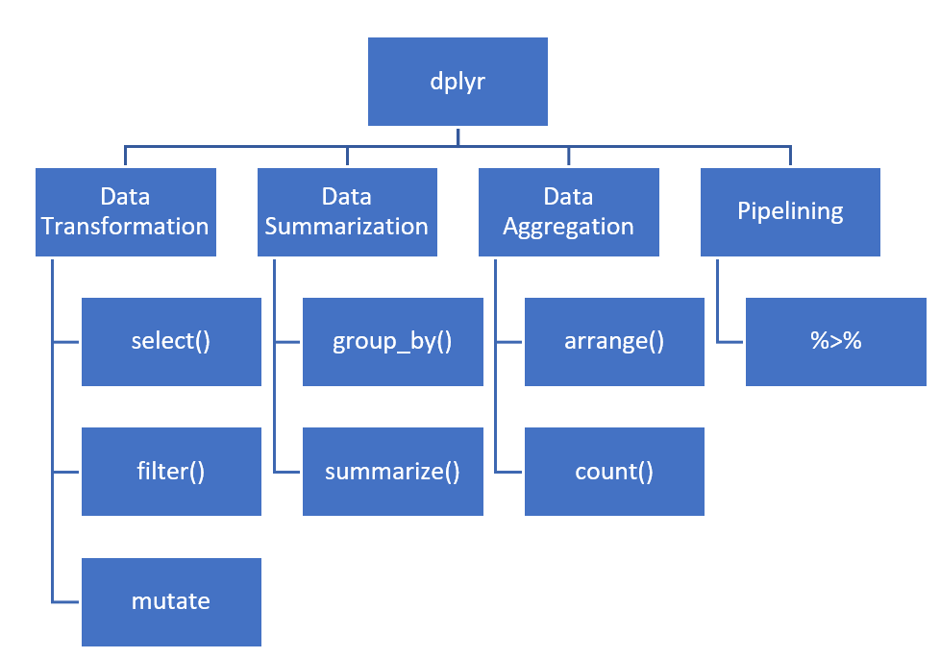
dplyr Package

Slide 14
Command Illustration
new_dataframe_name <- dataframe_name %>%
select(column_name1) %>%
select(-column_name2)

Slide 15
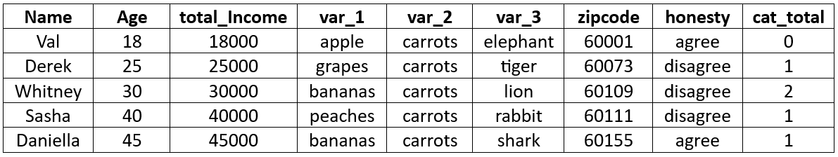
select() Function
Illustration_Data

Slide 16
Different ways to use `select()`
Choose specific column name from the data frame

Slide 17
Example 7: Select columns "Age" and "total_Income"
example_7 <- Illustration_Data %>%
select(Age, total_Income)
Output: The output is a dataframe that looks like this

Slide 18
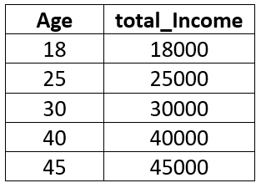
Output: The output is a dataframe that looks like this

Slide 19
2. Select Columns by Name Patterns: You can use special helper functions like:
    `starts_with()`
    `ends_with()`
    `contains()`
    `matches()`
    `everything()`
to select columns based on their names.

Slide 20
Example 8: Select columns that start with "var"
example_8 <- Illustration_Data %>%
select(starts_with(“var”))
Output: The output is a dataframe that looks like this

Slide 21
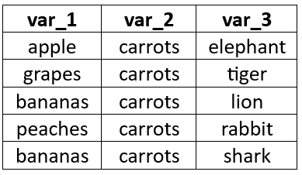
Output: The output is a dataframe that looks like this

Slide 22
Example 9: Select columns that contains "total" in their names
example_9 <- Illustration_Data %>%
select(contains("total"))
Output: The output is a dataframe that looks like this

Slide 23
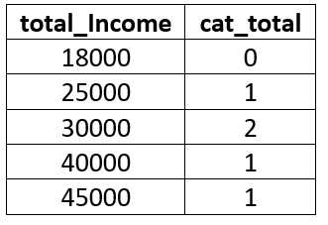
Output: The output is a dataframe that looks like this

Slide 24
3. Exclude Columns: To exclude specific columns, you can use the "-" (minus) sign before the column name.

Slide 25
Example 10: Exclude columns "honesty" and "zipcode"
example_10 <- Illustration_Data %>%
select(-honesty, -zipcode)
Output: The output is a dataframe that looks like this

Slide 26
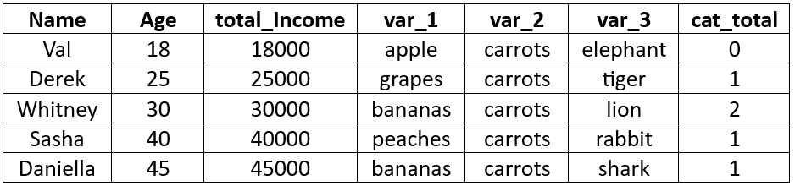
Output: The output is a dataframe that looks like this

Slide 27
4. Select Columns by Index and Range: you can use a numeric vector to select the columns according to their index position.

Slide 28
Example 11: Exclude columns "honesty" and "zipcode"
example_11 <- Illustration_Data %>%
select(c(1,3,5,6))
Output: The output is a dataframe that looks like this

Slide 29
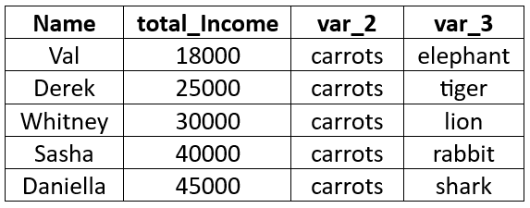
Output: The output is a dataframe that looks like this

